Slide 1

STA5005 Advanced NLP
Project 1
12112627
李 乐 平
2023.10

Slide 2
Part 1
Paper Reading

Slide 3
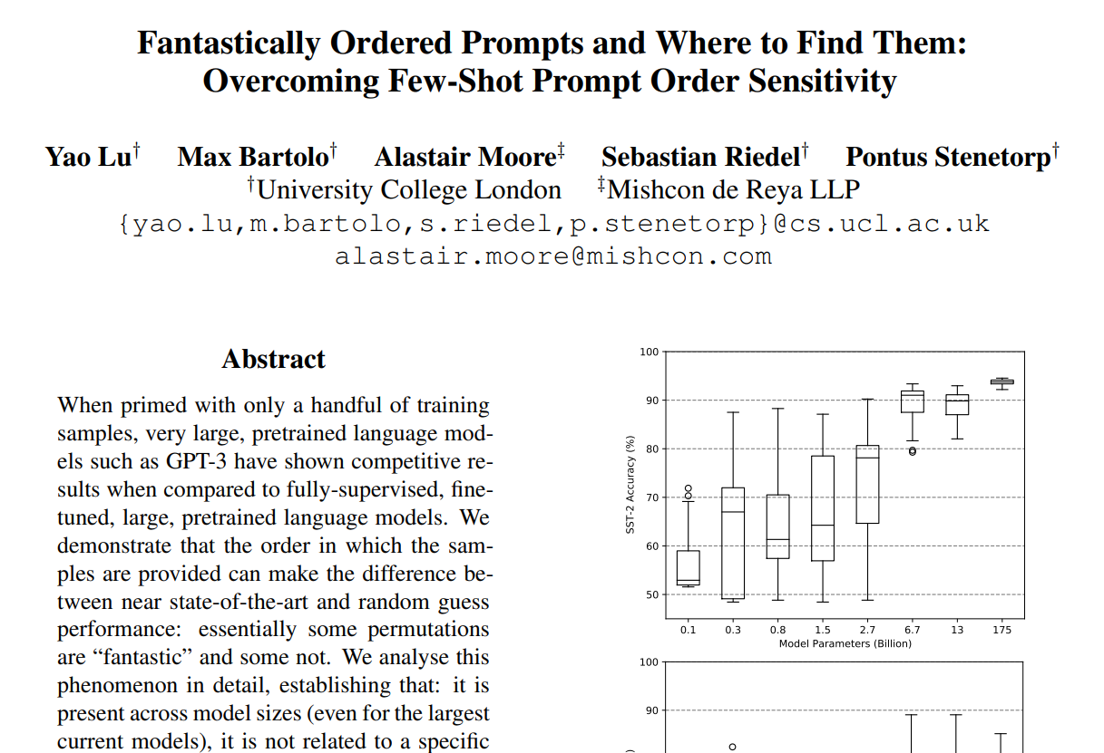

Paper Chosen
Department of Statistics and Data Science

Slide 4
What is the problem addressed in the paper?
在少样本预训练语言模型（Pretrained Language Model, PLM）的上下文学习（In-context Learning）中出现了顺序敏感性（Order Sensitivity）问题。
增大训练模型大小、增加样本数量等操作并不一定能够显著降低由顺序敏感性带来的方差。
在不同模型中展现良好表现的样本顺序并不一致。
Department of Statistics and Data Science

Slide 5

Is this a new problem?
论文中提到2020年Gao等人展示了上下文学习的顺序稳定性不如微调方法的，因此这不是一个新问题。但是，那篇文章并未深究样本顺序究竟如何影响上下文学习的表现。
Department of Statistics and Data Science

Slide 6
What is the scientific hypothesis that the paper is trying to verify?
论文希望验证其提出的局部熵（Local Entropy, LocalE）和全局熵（Global Entropy, GlobalE）度量方法能够有效地从探测集（Probing Set）中找到较优样本顺序，从而一定程度上规避顺序敏感性。
Department of Statistics and Data Science

Slide 7
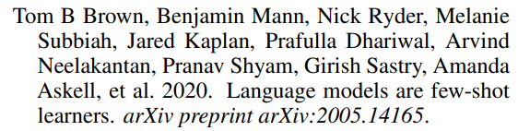
What are the key related works and who are the key people working on this topic?
论文主要围绕基于如下概念展开：上下文学习和顺序敏感性。
其中，与上下文学习相关的关键文章是Brown等人撰写的Language Model are Few-Shot Learners，这篇论文昭示了扩大语言模型的规模能够极大地提高其在任务无偏、少样本下的表现，甚至能与微调模型相媲美。
而Gao等人的Making pre-trained language models better few-shot learners则研究了基于提示词的微调方法，其提及了调换句子的顺序会导致表现的巨大偏差，但未进行更深入的研究。
……
Department of Statistics and Data Science

Slide 8
What is the key of the proposed solution in the paper?
解决问题的关键在于「探测集」的构建以及评价样本顺序优劣的度量方法。一个探测集由若干随机选出的样本进行多次排列，分别供给预训练模型进行训练后生成的提示词拼接组成。文中提到了两种可能的评价方法：全局熵和局部熵。在选用一种评价方法应用于探测集后，对探测集中的提示词进行排序，可以得到一个基于评价方法的提示词排名。论文认为排名高的提示词表现更佳，可以有效地对应到一种较优的样本顺序。
Department of Statistics and Data Science

Slide 9
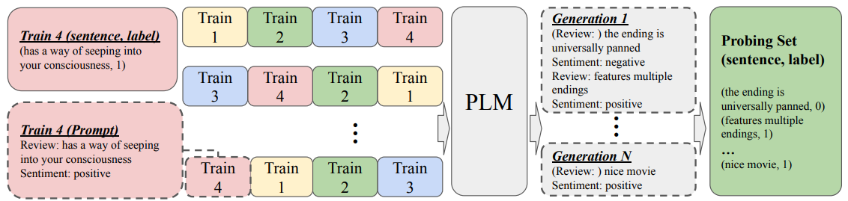
What is the key of the proposed solution in the paper?
§探测集的构建
Department of Statistics and Data Science

Slide 10




What is the key of the proposed solution in the paper?
§度量方法
全局熵 Global Entropy
Department of Statistics and Data Science

Slide 11


What is the key of the proposed solution in the paper?
§度量方法
局部熵 Local Entropy
Department of Statistics and Data Science

Slide 12
How are the experiments designed?
实验基于5组，每组4个随机样本构成的24种排列分别作为预训练模型的训练样本，生成了5个探测集。（GPT-3组仅基于2组，每组12种排列）
在每个探测集上，基于选定的评估方法，分别选出了k组最优的顺序，并基于此在多个数据集上计算了平均表现与方差。
实验还提供了表现的上界与随机基准。
Department of Statistics and Data Science

Slide 13
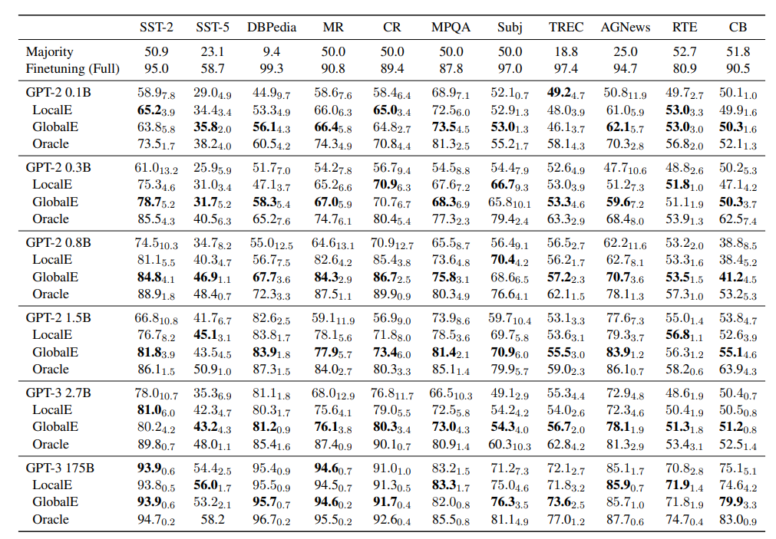
How are the experiments designed?
§论文设计的实验
Department of Statistics and Data Science

Slide 14
What datasets are built/used for quantitative evaluation? Is the code open sourced?
实验采用了SST-2、SST-5、DBPedia、MR、CR、MPQA、Subj、TREC、AGNews、RTE和CB等11个数据集。
文中附录给出了11个数据集对应的论文链接，但是并没有给出用于实验的源代码。
Department of Statistics and Data Science

Slide 15
Is the scientific hypothesis well supported by evidence in the experiments?
实验表明基于局部熵指标和全局熵指标构筑的样本顺序相比基准模型（随机）的表现分别取得了9.6%和13%的平均相对提升。
同时，文中还提到基于这些熵指标的探测方法具有稳健性和跨模板性（模板指将句子和标签拼接成格式化字符串的方式），基于此操作的顺序选择不会产生负面效果（即表现不会亚于随机选择）。
Department of Statistics and Data Science

Slide 16
What are the contributions of the paper?
论文研究了上下文学习中的顺序敏感性，并昭示了其在少样本学习中的重要性。然后，其提出了一种能够不依赖额外数据的有效寻找良好顺序的探测方法，并为此提供了局部熵和全局熵两种评价指标。最后，其展示了这种方法在不同规模、不同模型和不同数据集上的通用性。
Department of Statistics and Data Science

Slide 17
What should/could be done next?
论文中提出的两种评价方法均未达到最优，还有提升空间，因此可以探索其他的评价方法。另外，论文还提到对于较小模型上的句对任务（Sentence-pair task），即使采用最优的顺序，其效果仍欠佳。
除此之外，关于顺序敏感性的成因以及是否存在更加底层的规避方法也值得研究。
Department of Statistics and Data Science

Slide 18
Part 2
LLM-aided Task Solving

Slide 19
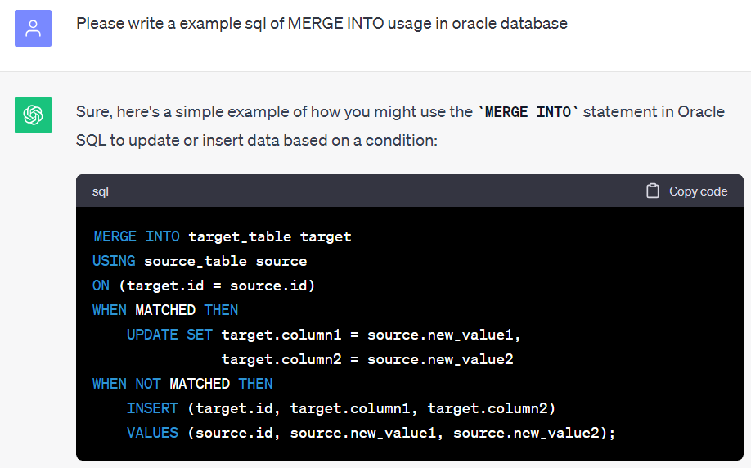
Task 1
§目标
在Python脚本中编写批量执行Oracle数据库MERGE INTO语句的脚本，以实现通用化的插入/更新操作。
Department of Statistics and Data Science

Slide 20
Task 1
§问题
这是一句固定的执行语句，无法泛化。
Department of Statistics and Data Science

Slide 21
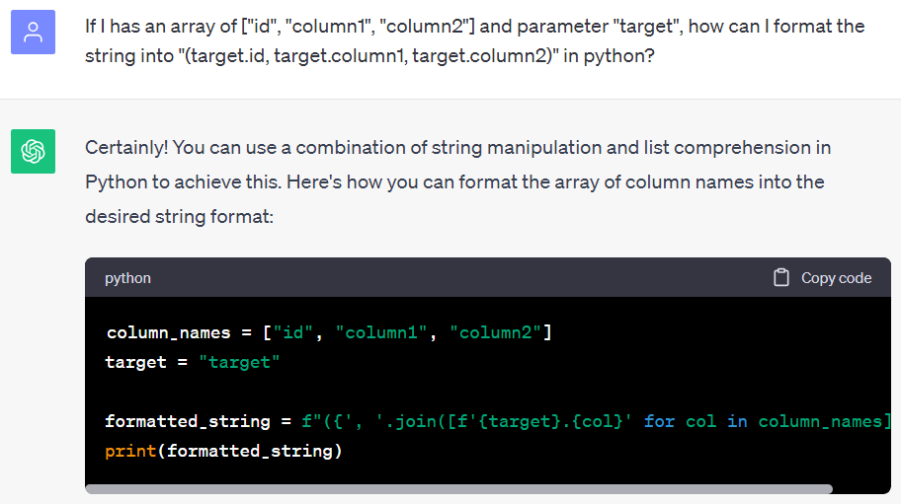
Task 1
§目标
将设置好的列名拼接成格式化的字符串，朝通用化迈进。
Department of Statistics and Data Science

Slide 22
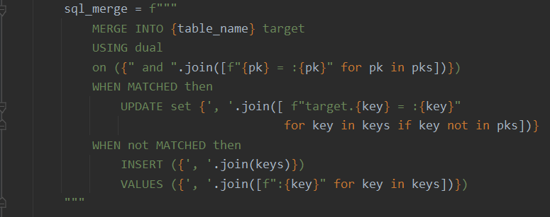
Task 1
§阶段性成果
Department of Statistics and Data Science

Slide 23
Task 1
§问题
报错：ORA-00932 数据类型不一致: 应为 CHAR, 但却获得 NUMBER
Department of Statistics and Data Science

Slide 24
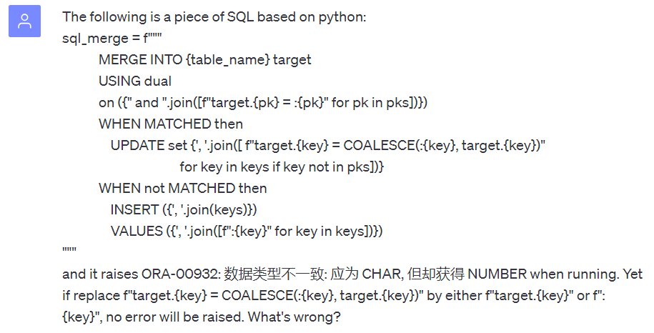
Task 1
§目标
解决报错ORA-00932
Department of Statistics and Data Science

Slide 25
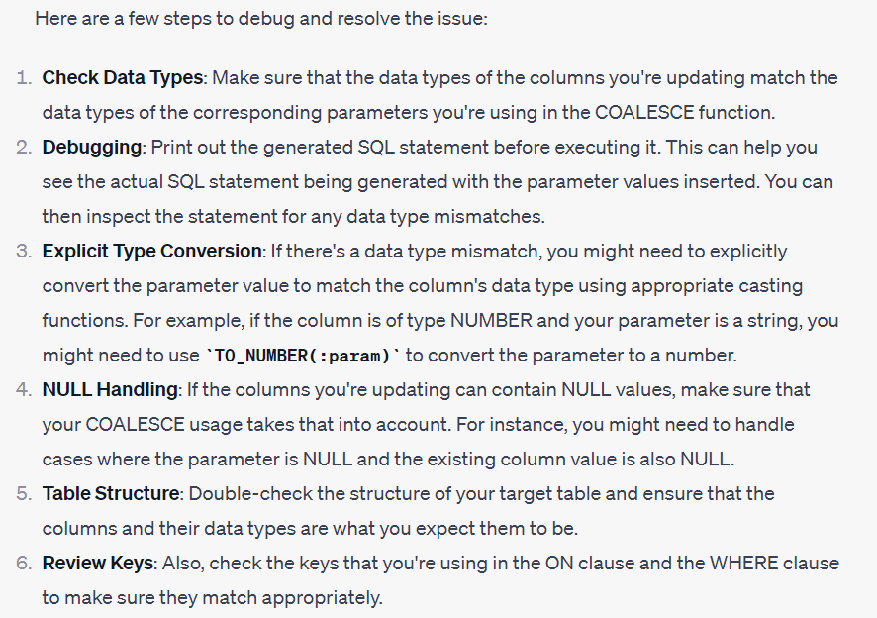


Task 1
§问题
ChatGPT开始标志性地讲大道理
ChatGPT
我
Department of Statistics and Data Science

Slide 26
Task 1
§后续（省流版）
——尝试向说明待插入的值和数据库中的值类型均没有明显问题，无果
——尝试使用COALESCE和CASE语句进行空值处理，无果
——尝试定位报错的具体位置，无果
——尝试根据数据库中列类型对Python中列表值进行强制转换，有效
——发现在某些条件下，脚本进行了意外的插入而非更新
——尝试定位报错的具体位置，无果
——尝试使用部分列进行更新，更新成功，由此发现字符补位问题
——尝试用TRIM去首尾空值，成功
总耗时：>15小时
Department of Statistics and Data Science

Slide 27
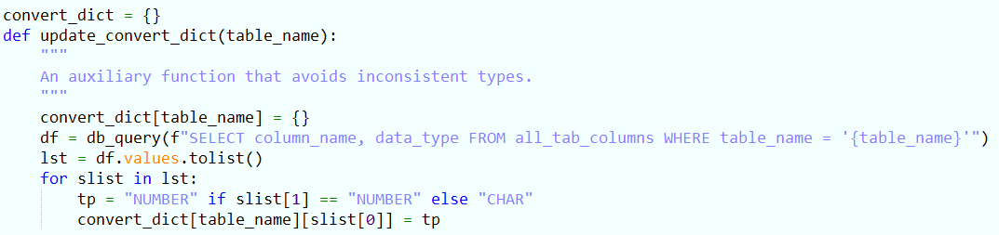
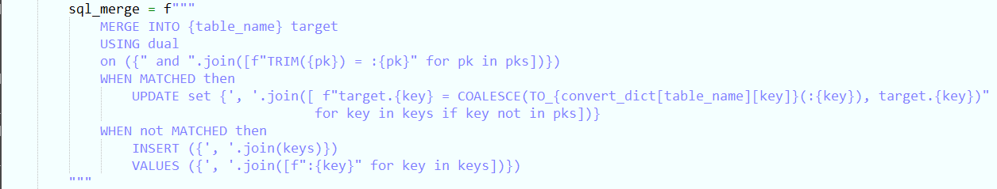
Task 1
§最终结果
Department of Statistics and Data Science

Slide 28
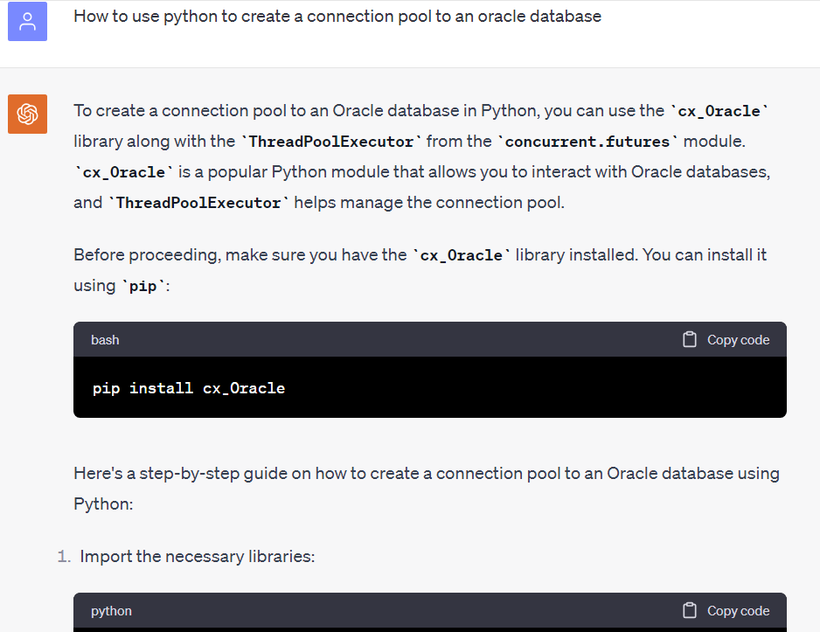
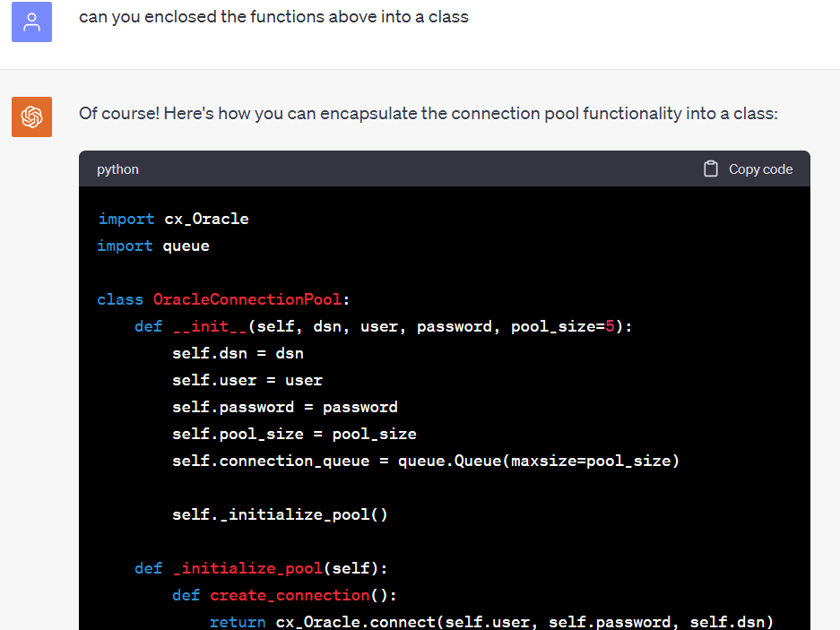
Task 2
§目标
创建一个Oracle数据库连接池。
Department of Statistics and Data Science

Slide 29
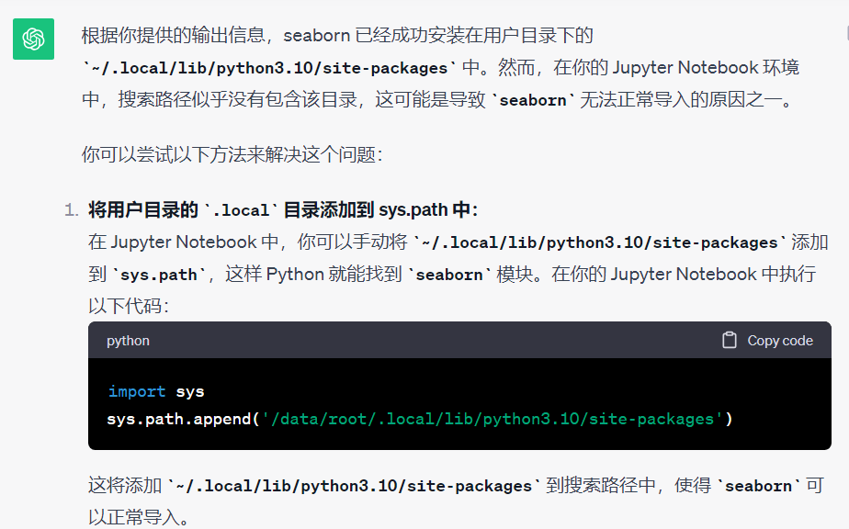
Task 3
§目标
通过服务器的JupyterLab端口顺利安装一个Python库，并解决路径问题
「
以下是运行
!python -m pip install -i https://pypi.tuna.tsinghua.edu.cn/simple --user --upgrade seaborn sys.path
的结果：
Looking in indexes: https://pypi.tuna.tsinghua.edu.cn/simple, https://pypi.ngc.nvidia.com
Requirement already satisfied: seaborn in /data/root/.local/lib/python3.10/site-packages (0.13.0)
Requirement already satisfied: numpy!=1.24.0,>=1.20 in /usr/local/lib/python3.10/dist-packages (from seaborn) (1.22.2)
Requirement already satisfied: pandas>=1.2 in /usr/local/lib/python3.10/dist-packages (from seaborn) (1.5.3)
Requirement already satisfied: matplotlib!=3.6.1,>=3.3 in /usr/local/lib/python3.10/dist-packages (from seaborn) (3.7.3)
Requirement already satisfied: contourpy>=1.0.1 in /usr/local/lib/python3.10/dist-packages (from matplotlib!=3.6.1,>=3.3->seaborn) (1.1.0)
Requirement already satisfied: cycler>=0.10 in /usr/local/lib/python3.10/dist-packages (from matplotlib!=3.6.1,>=3.3->seaborn) (0.11.0)
Requirement already satisfied: fonttools>=4.22.0 in /usr/local/lib/python3.10/dist-packages (from matplotlib!=3.6.1,>=3.3->seaborn) (4.42.1)
Requirement already satisfied: kiwisolver>=1.0.1 in /usr/local/lib/python3.10/dist-packages (from matplotlib!=3.6.1,>=3.3->seaborn) (1.4.5)
Requirement already satisfied: packaging>=20.0 in /usr/local/lib/python3.10/dist-packages (from matplotlib!=3.6.1,>=3.3->seaborn) (23.1)
Requirement already satisfied: pillow>=6.2.0 in /usr/local/lib/python3.10/dist-packages (from matplotlib!=3.6.1,>=3.3->seaborn) (9.2.0)
Requirement already satisfied: pyparsing>=2.3.1 in /usr/local/lib/python3.10/dist-packages (from matplotlib!=3.6.1,>=3.3->seaborn) (3.1.1)
Requirement already satisfied: python-dateutil>=2.7 in /usr/local/lib/python3.10/dist-packages (from matplotlib!=3.6.1,>=3.3->seaborn) (2.8.2)
Requirement already satisfied: pytz>=2020.1 in /usr/local/lib/python3.10/dist-packages (from pandas>=1.2->seaborn) (2023.3)
Requirement already satisfied: six>=1.5 in /usr/local/lib/python3.10/dist-packages (from python-dateutil>=2.7->matplotlib!=3.6.1,>=3.3->seaborn) (1.16.0)
WARNING: Running pip as the 'root' user can result in broken permissions and conflicting behaviour with the system package manager. It is recommended to use a virtual environment instead: https://pip.pypa.io/warnings/venv class="ansi-yellow-fg">
['/data/lab/STA303/ass1/STA303-Assignment01',
'/usr/lib/python310.zip',
'/usr/lib/python3.10',
'/usr/lib/python3.10/lib-dynload',
'',
'/usr/local/lib/python3.10/dist-packages',
'/usr/lib/python3/dist-packages']
，应该如何做才能使seaborn正常import
」
Department of Statistics and Data Science

Slide 30
Summary
§如何更加高效地使用LLM辅助完成任务？
—改进提示词的顺序？
—尝试不同的提示词？
Department of Statistics and Data Science

Slide 31
Summary
§如何更加高效地使用LLM辅助完成任务？
道——专注当前的问题
法——选择合适的途径——化繁为简，拆分任务
术——选择合适的方法——ChatGPT or StackOverflow? 「or」.
器——熟练地使用工具——使提示词更准确
Department of Statistics and Data Science

Slide 32
Thanks for Watching

